Slide 1

College Park FoodAdvisor
Project_0503_08
Dec 10, 2021

Slide 2

Background
Our brand, FoodAdvisor is a food review system which aims to assist customers in finding restaurants around college park.
Customers can check out the ratings and reviews of the restaurants which they wish to visit.
They can also find out the cuisine and highlights of each restaurant along with the additional services offered by them.
Since College park is known for having the largest university in Maryland which is the University of Maryland - College Park, the main users would be the university students and staff members. Other customers would be the locals, food bloggers and people travelling across Maryland. The restaurant owners could also reflect on customer reviews.
Data Source: Tripadvisor.com

Slide 3

Mission Statements and Mission Objectives
Mission Statement:
To analyze the reviews of various restaurants at College Park written by the customers who have visited the restaurants in order to help future customers decide on which restaurant to visit.
Mission Objectives:
To determine the restaurants with highest customer rating.
To find negative reviews in order to get feedback and improve.
To find the the best affordable restaurants around College Park.
To find the establishments in College Park that offer Bar service.
To find the restaurants that offer late night service and till what time will they be operating.
Notes:
To determine the restaurants with highest customer rating.
To find the restaurants that offer late night service and till what time will they be operating.
To find the the best affordable restaurants around College Park.
To find the establishments in College Park that offer Bar service.
To find negative reviews in order to get feedback and improve.

Slide 4
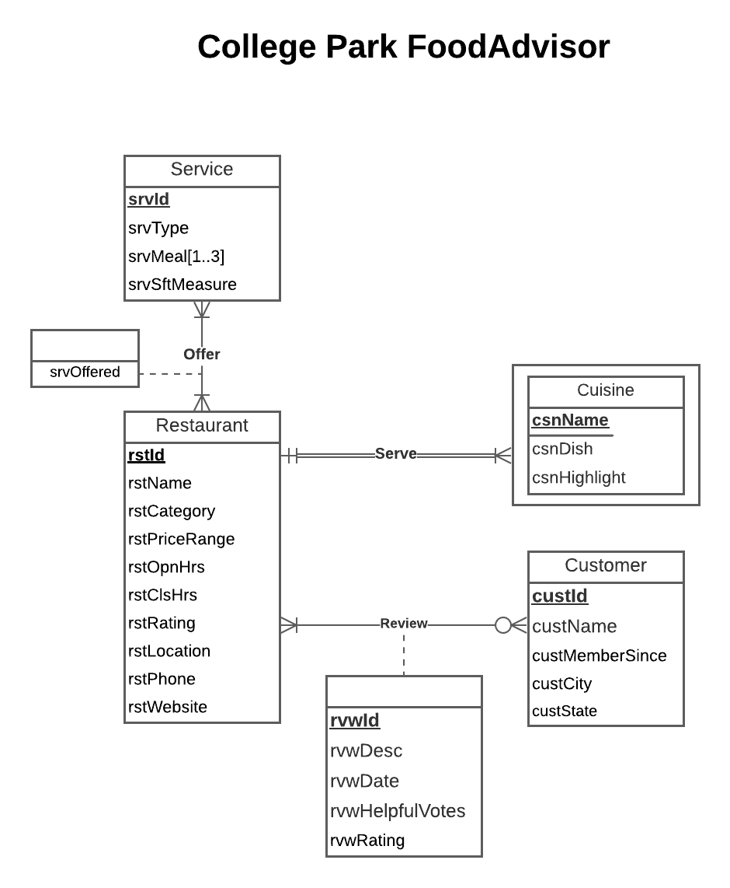
Conceptual Database Design: ER Diagram

Slide 5
Logical Database Design: Relational Schema
Restaurant (rstId, rstName, rstCategory, rstPriceRange, rstOpnHrs, rstClsHrs, rstRating, rstLocation, rstPhone, rstWebsite)
Customer (custId, custName, custMemberSince, custCity, custState)
Cuisine (rstId, csnName, csnDish, csnHighlight)
Service (srvId, srvType, srvSftMeasure)
ServedMeal (srvId, srvMeal)
Offer (rstId, srvId, srvOffered)
Review(rvwId, rvwDesc, rvwDate, rvwHelpfulVotes, rvwRating, rstId, custId)

Slide 6
Physical Database Design
CREATE TABLE [FoodAdvisor.Review] (
rvwId CHAR(10) NOT NULL,
rvwDesc VARCHAR(MAX),
rvwDate DATE,
rvwHelpfulVotes INTEGER,
rvwRating DECIMAL(2,1),
rstId VARCHAR(10),
custId VARCHAR(20),
CONSTRAINT pk_Review_rvwId PRIMARY KEY (rvwId),
CONSTRAINT fk_Review_rstId FOREIGN KEY (rstId)
REFERENCES [FoodAdvisor.Restaurant] (rstId)
ON DELETE NO ACTION ON UPDATE CASCADE,
CONSTRAINT fk_Review_custId FOREIGN KEY (custId)
REFERENCES [FoodAdvisor.Customer] (custId)
ON DELETE NO ACTION ON UPDATE CASCADE)

Slide 7
Use Case 1
What are the restaurants that serve ‘American’ cuisine and what is their cuisine highlight?
CREATE VIEW AmericanCuisine AS
SELECT r.rstId, r.rstName, c.csnName, c.csnHighlight
FROM [FoodAdvisor.Restaurant] r, [FoodAdvisor.Cuisine] c
WHERE r.rstId = c.rstId AND c.csnName = 'American'
WITH CHECK OPTION;

Slide 8
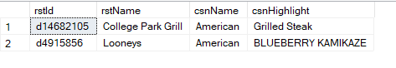
Application
What are the restaurants that serve ‘American’ cuisine and what is their cuisine highlight?

Slide 9
Use Case 2
Which restaurant serves 'Sushi' and has the best consumer ratings?
CREATE VIEW Sushi AS
SELECT TOP 1 r.rstName, rt.csnHighlight, cast(rt.avg_rating as decimal(4,2)) customer_rating
FROM [FoodAdvisor.Restaurant] r
INNER JOIN(
SELECT AVG(rv.rvwRating) avg_rating, rv.rstId, c.csnHighlight
FROM [FoodAdvisor.Restaurant] r, [FoodAdvisor.Cuisine] c, [FoodAdvisor.Review] rv
WHERE r.rstId = c.rstId
AND c.csnHighlight = 'Sushi'
AND r.rstId = rv.rstId
GROUP BY rv.rstId, c.csnHighlight) rt
ON r.rstId = rt.rstId
ORDER BY avg_rating DESC
WITH CHECK OPTION;

Slide 10
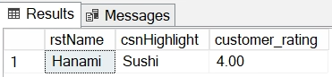
Application
Which restaurant serves 'Sushi' and has the best consumer ratings?

Slide 11
Use Case 3
What are the restaurants that offer late night service and till what time will they be operating?
CREATE VIEW LateNightService AS
SELECT r.rstName, r.rstClsHrs, o.srvOffered
FROM [FoodAdvisor.Restaurant] r, [FoodAdvisor.Offer] o
WHERE r.rstId = o.rstId AND o.srvOffered = 'LATE NIGHT'
WITH CHECK OPTION;

Slide 12
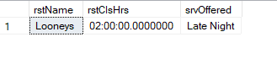
Application
What are the restaurants that offer late night service and till what time will they be operating?

Slide 13
Use Case 4
Which are the best affordable restaurants that offer takeout option for dinner?
CREATE VIEW TakeoutDinner AS
SELECT r.rstName, r.rstPriceRange, s.srvType, sm.srvMeal
FROM [FoodAdvisor.Restaurant] r, [FoodAdvisor.Offer] o,
[FoodAdvisor.Service] s, [FoodAdvisor.ServedMeal] sm
WHERE r.rstPriceRange = 'Cheap Eats'
AND r.rstId = o.rstId
AND o.srvId = s.srvId
AND s.srvType = 'takeout'
AND s.srvId = sm.srvId
AND sm.srvMeal = 'dinner'
WITH CHECK OPTION;

Slide 14
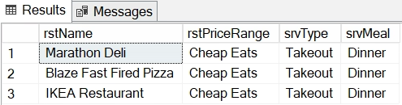
Application
Which are the best affordable restaurants that offer takeout option for dinner?

Slide 15
Use Case 5
Which establishments in College Park offer Bar service?
CREATE VIEW Bars AS
SELECT *
FROM [FoodAdvisor.Restaurant] r
WHERE r.rstCategory LIKE '%bar%'
WITH CHECK OPTION;

Slide 16

Application
Which establishments in College Park offer Bar service?

Slide 17
Use Case 6
What are the latest reviews for every restaurant?
CREATE VIEW LatestReviews AS
SELECT r.rstId, r.rstName, rv.rvwDesc, rv.rvwDate
FROM [FoodAdvisor.Restaurant] r, [FoodAdvisor.Review] rv
WHERE rv.rvwDate =
(SELECT MAX(rv.rvwDate)
FROM [FoodAdvisor.Review] rv
WHERE r.rstId = rv.rstId)
WITH CHECK OPTION;

Slide 18
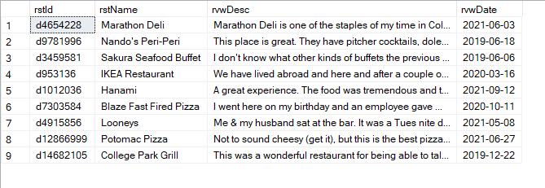
Application
What are the latest reviews for every restaurant?

Slide 19
Use Case 7
Which mid-range restaurants offer lunch service?
CREATE VIEW Mid_rangeLunch AS
SELECT r.rstName, r.rstPriceRange, sm.srvMeal
FROM [FoodAdvisor.Restaurant] r, [FoodAdvisor.Offer] o, [FoodAdvisor.ServedMeal] sm
WHERE r.rstPriceRange = 'Mid-Range'
AND r.rstId = o.rstId
AND o.srvId = sm.srvId
AND sm.srvMeal = 'lunch'
WITH CHECK OPTION;

Slide 20
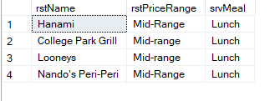
Application
Which mid-range restaurants offer lunch service?

Slide 21
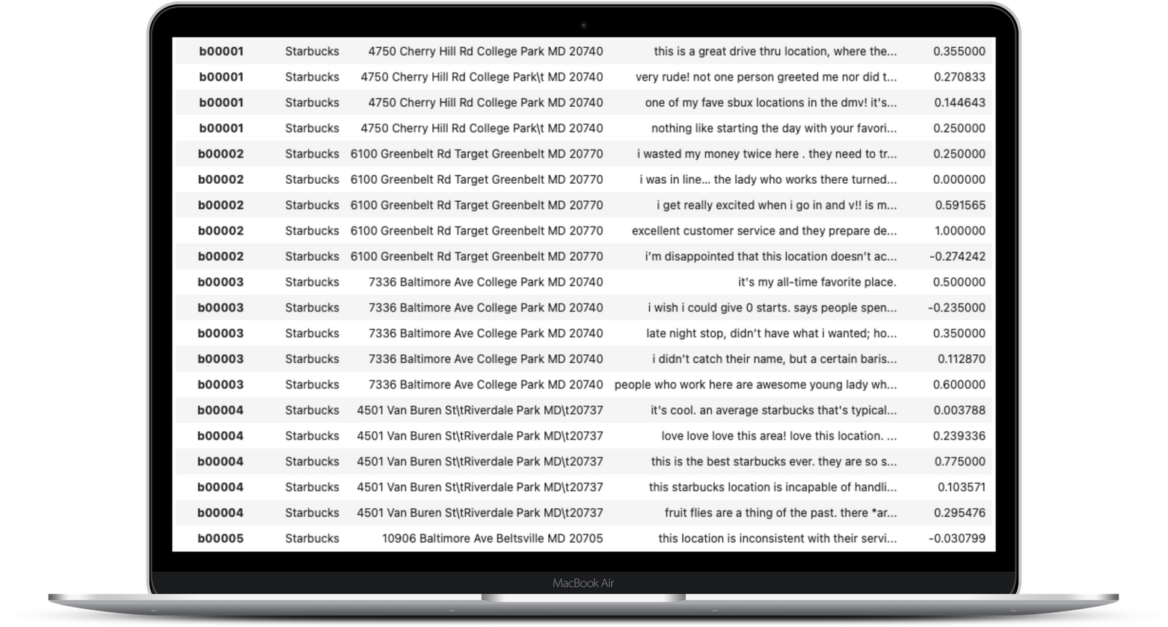
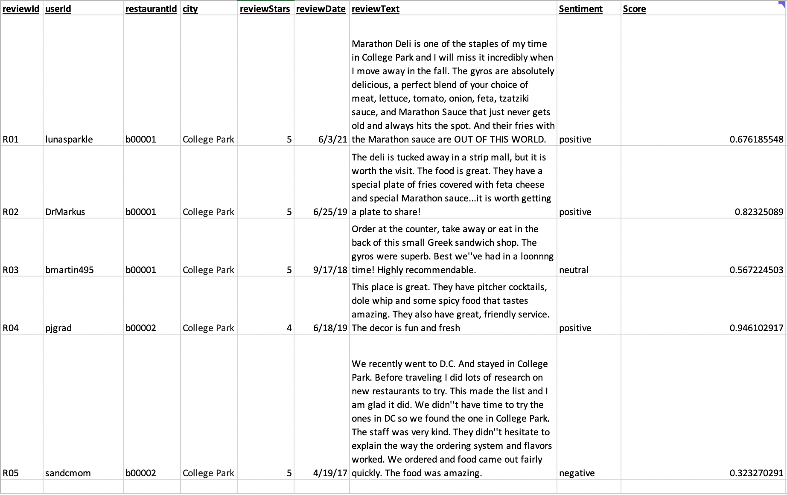


Sentiment Analysis
Determine polarity of reviews
Better understand customer sentiment

Slide 22
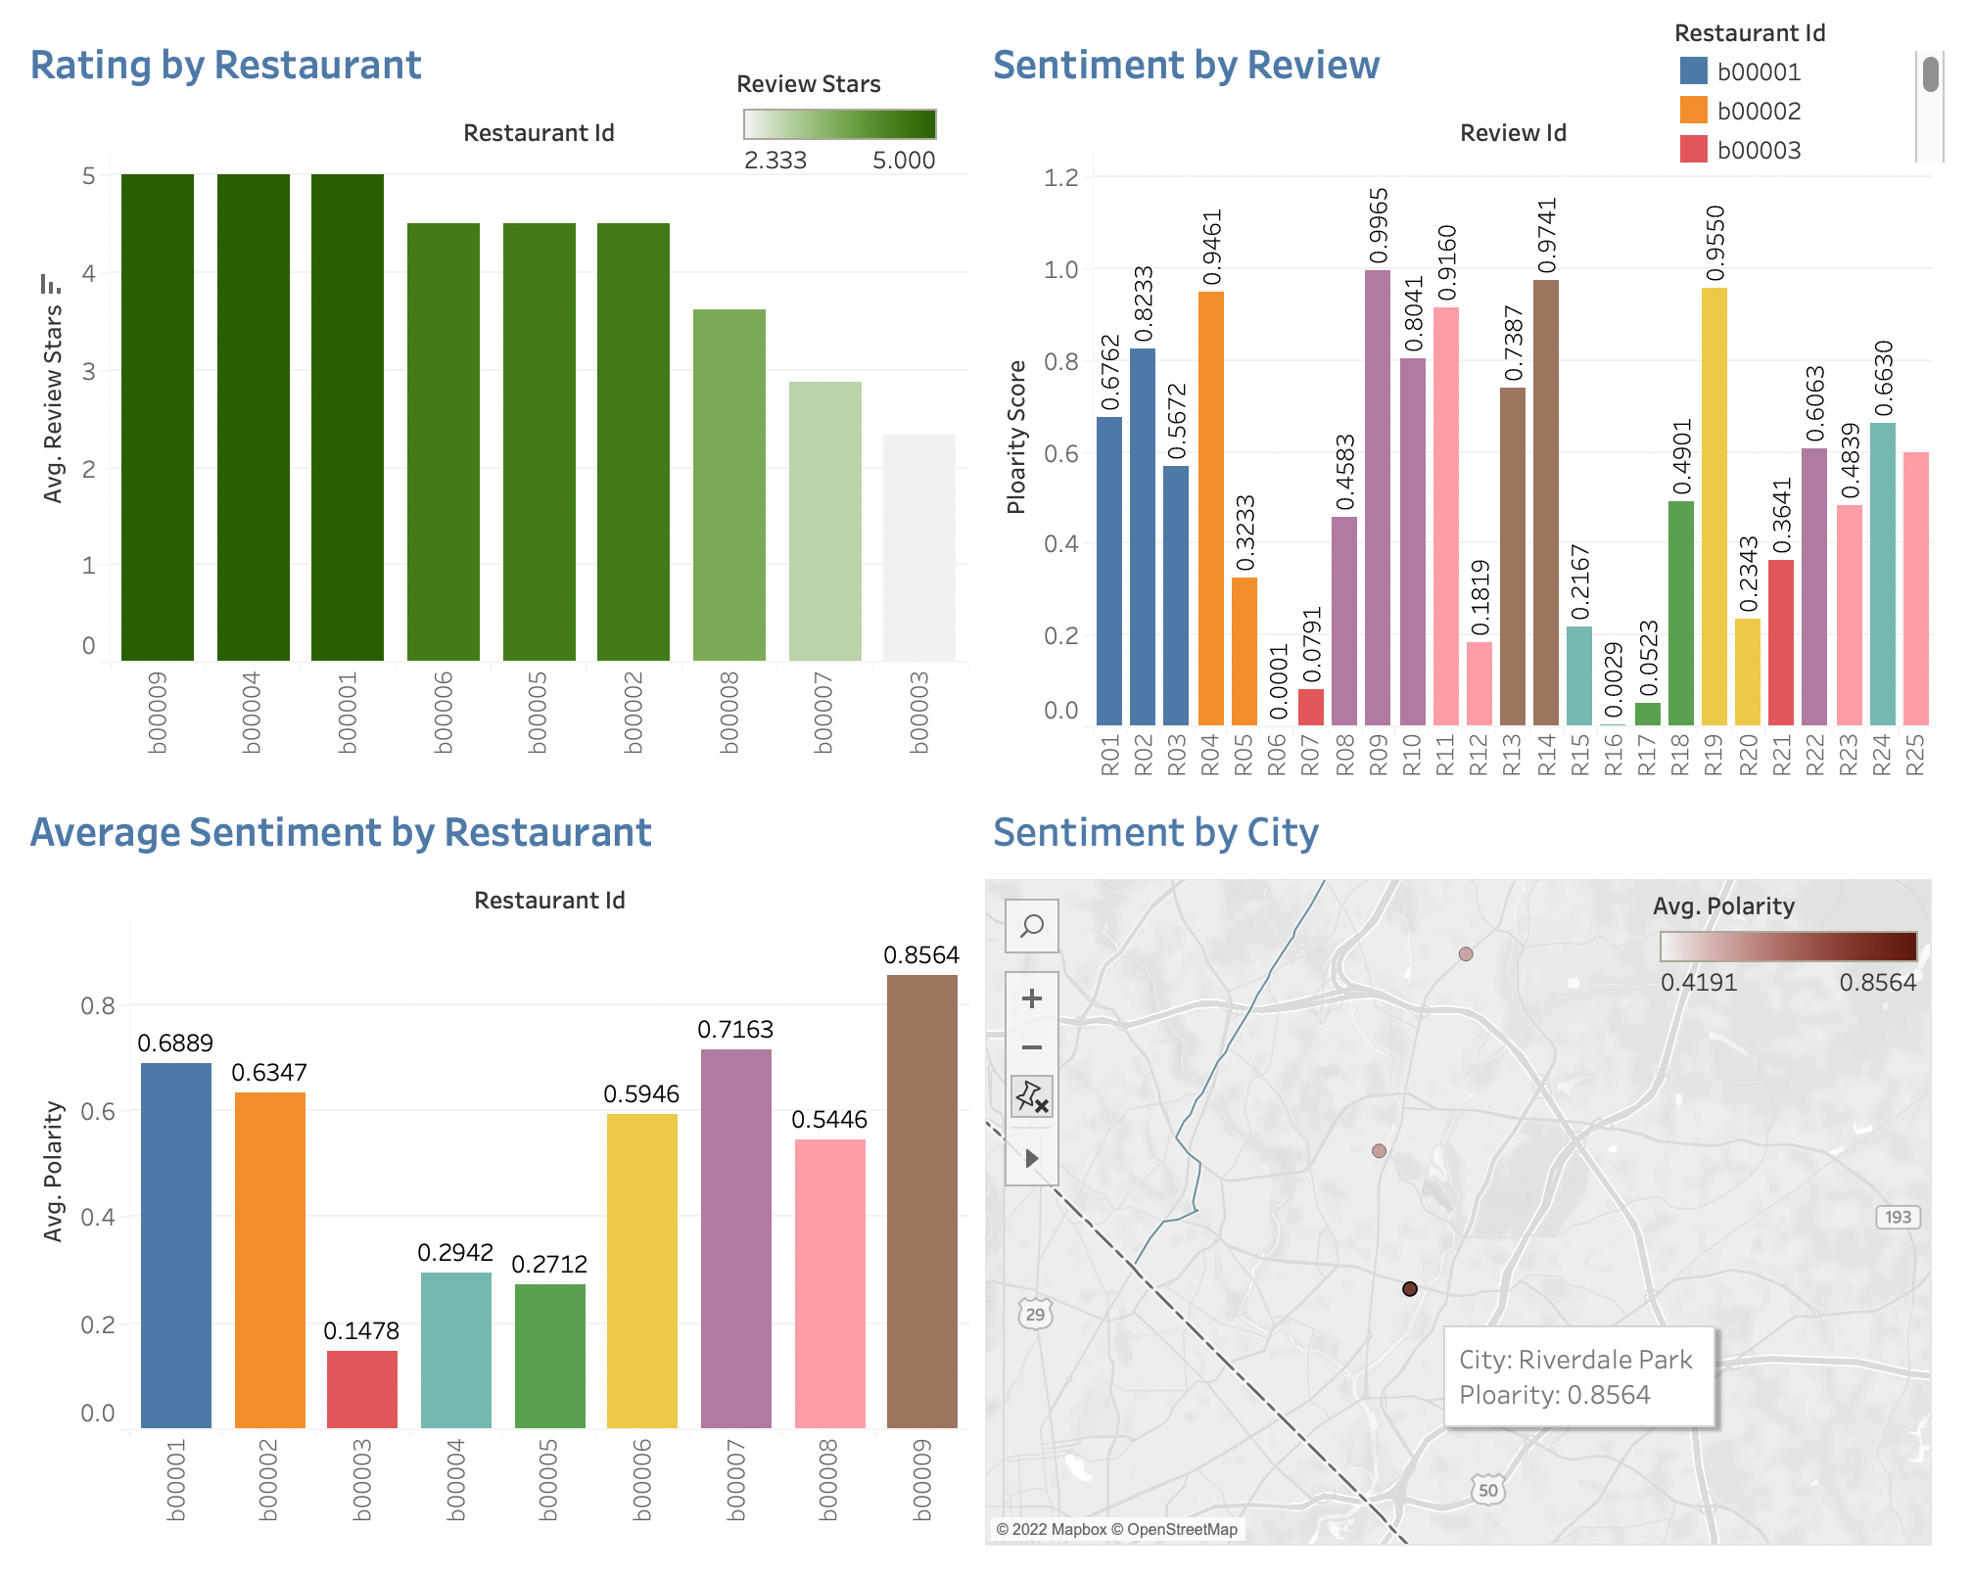
Dashboard

Slide 23


